Slide 1

Hierarchical Reinforcement Learning for Course Recommendation in MOOCs
Jing Zhang, Bowen Hao, Bo Chen, Cuiping Li, Hong Chen (Renmin University)
Jimeng Sun (Georgia Institute of Technology)

Slide 2
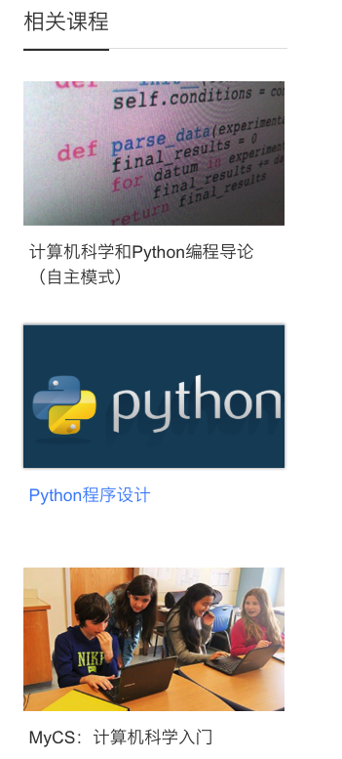




Course Recommendation
Related courses
Notes:
Nowadays, massive open online courses, or MOOCs, are attracting widespread interest as an alternative education model.
Lots of MOOCs platforms such as Coursera, edX and Udacity have been built and provide low cost opportunities for anyone to access a massive number of courses from the worldwide top universities.
The proliferation of heterogeneous courses in MOOCs platforms demands an effective way of personalized course recommendation for their users.

Slide 3








Problem Definition
Input:
Historical enrolled courses of a user before t
Candidate Courses:
Output:
Most possible courses to be enrolled at t+1

Slide 4
Challenges
Users’ enrolled courses are usually diverse
Contributing courses may be diluted by noisy courses
Contributing courses
Contributing
courses
Noisy courses
Positive instance
Negative instance
Attention coefficients
Each course is assigned an attention coefficient, regardless of its relevance
[He’18]

Slide 5
Data Analysis
Users
Courses
Categories
User-course pairs
Time
82,535
1,302
23
458,454
2016.10.1-2018.3.31
A large number of users enrolled diverse courses
The recommendation performance based on the diverse profiles is impacted
(A bigger #categories/#courses indicates the user is more distractive)

Slide 6
Idea to Deal with the Challenges
Attention coefficients
Remove noisy courses
Without supervised information, how to determine to remove which courses?

Slide 7
Solution
Revise the user profiles based on the feedbacks from the recommender
Feedback
Profile Reviser
Recommender
Revised profiles
Agent
Environment
Notes:
The revising process of a user profile: a sequential decision process
The profile reviser (agent)
Revise the profile
Gets a delayed reward from the recommender
Update its policy
The recommender (environment)
Update its parameters based on the profiles revised by the profile reviser

Slide 8
Framework
Update revised profile
Update recommendation model
Original profile
High-level action
Revise
Not revise
Low-level actions

Slide 9
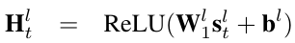
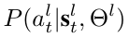
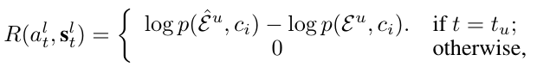
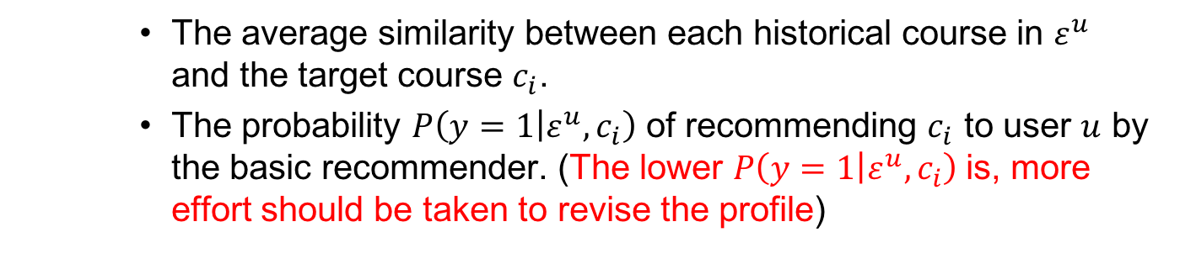
The High-level Task
Determine whether to revise the whole profile $ε^{u}$ or not
The average similarity between each historical course in $ε^{u}$ and the target course $c_{i}$.
The probability $P\left(y=1 | ε^{u},c_{i}\right)$ of recommending $c_{i}$ to user $u$ by the basic recommender. (The lower $P\left(y=1 | ε^{u},c_{i}\right)$is, more effort should be taken to revise the profile)
State:
Action: {Revise, keep}
Policy function: two-layer NN
State
Action probability
Delayed reward:
The difference between the log-likelihood after and before the profile is revised.

Slide 10
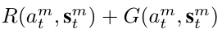
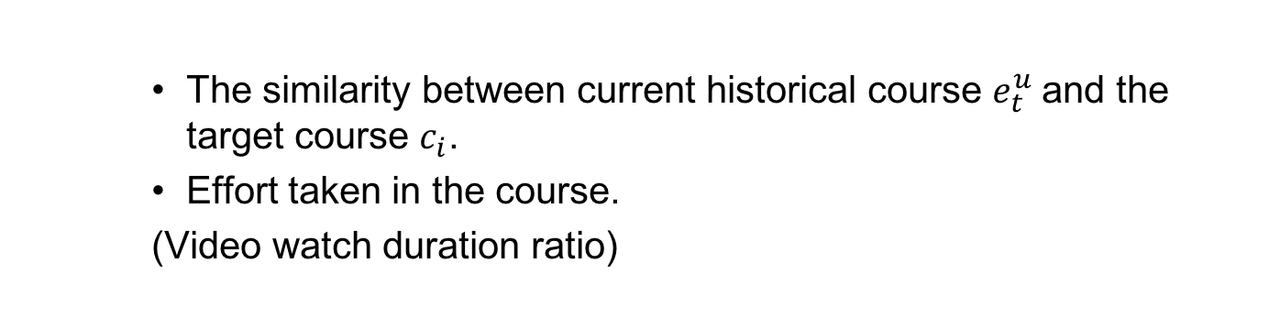
The Low-level Task
Determine whether to remove a historical course $e_{t}^{u}∈$ $ε^{u}$ or not
The similarity between current historical course $e_{t}^{u}$and the target course $c_{i}$.
Effort taken in the course.
(Video watch duration ratio)
State:
Action: {Remove, keep}
State
Delayed reward:
Internal reward
[Ghavamzadeh’03]
The difference between the average similarity between each historical course and the target course after and before the profile is revised.

Slide 11
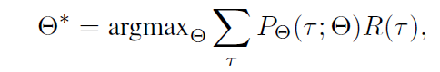
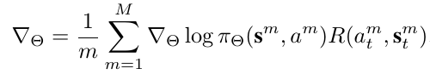
Objective Function
Maximize the expected reward:
Update the policy network with policy gradient:
A sequence of the sampled actions and the transited states
Sampling probability
The reward for the sampled sequence

Slide 12
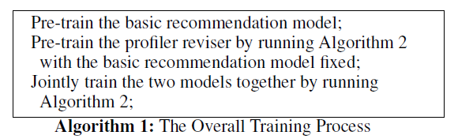
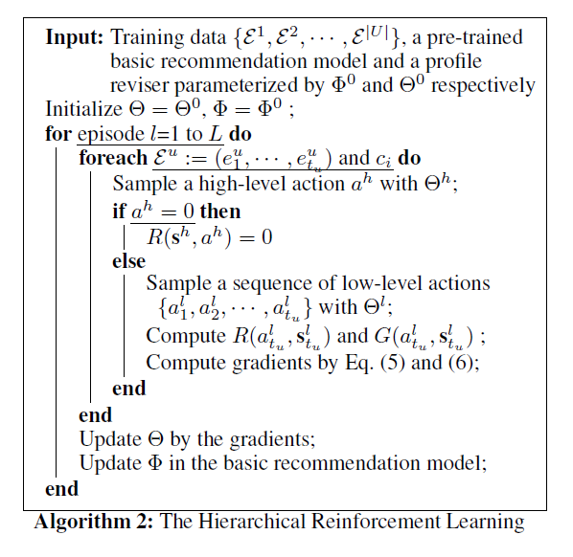
Training Procedure
Pre-train +joint train
Sample actions and transited states and get rewards
Update profile reviser and recommender

Slide 13
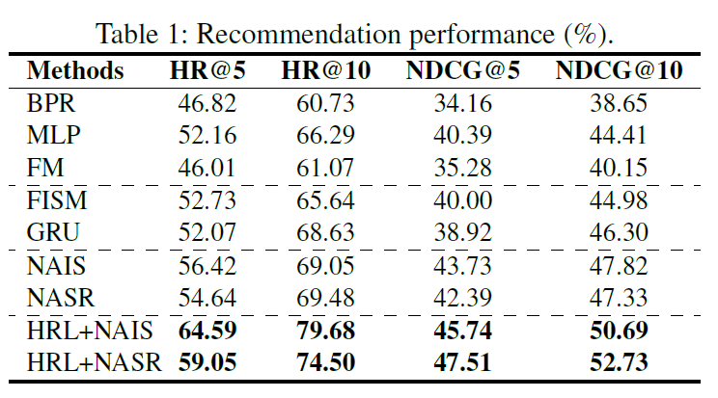
Experiment Results
User-item model
Item-item model, average
Attention model
RL model

Slide 14
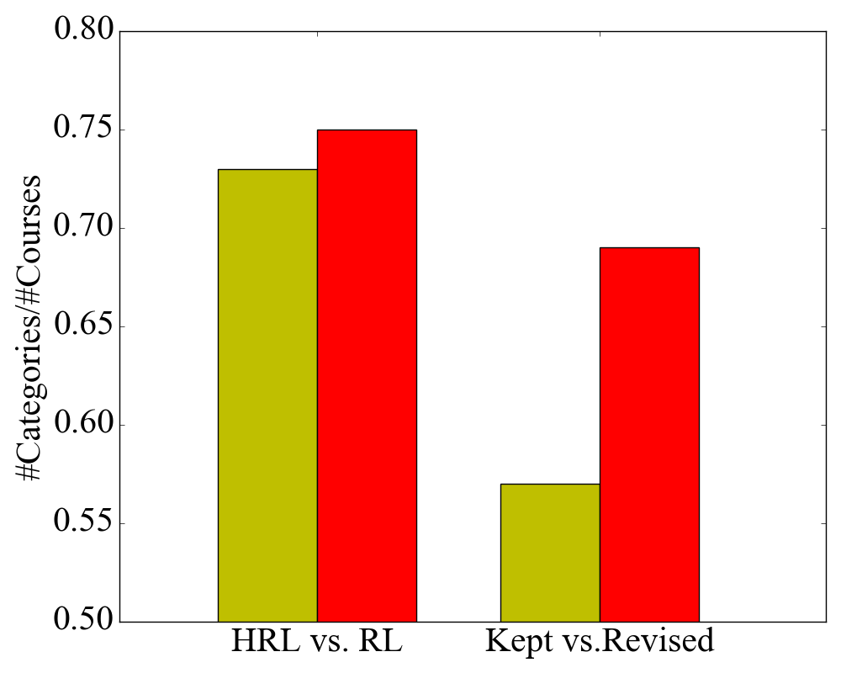
Compared with One-level RL
#Categories/#Courses
HRL vs. RL
HRL revised profiles vs. RL revised profiles
HRL high-level task
Kept profiles vs. revised profiles
(A bigger #categories/#courses indicate the user is more distractive)

Slide 15
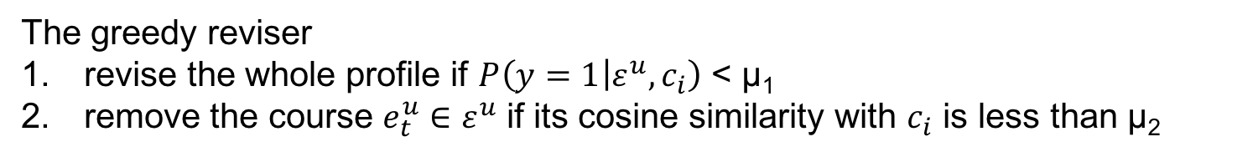
Compared with Greedy Revision
The greedy reviser
revise the whole profile if $P\left(y=1 | ε^{u},c_{i}\right)$ < µ₁
remove the course $e_{t}^{u}∈$ $ε^{u}$ if its cosine similarity with $c_{i}$ is less than µ₂

Slide 16
Compared with Attentions
HRL+NAIS:
Crisis Negotiation
Social Civilization
Web Technology
C++ Program
Web Development
NAIS:
29.61
29.09
28.32
28.12
The target course
HRL+NAIS:
Modern Biology
Medical Mystery
Biomedical Imaging
R Program
Biology
NAIS:
37.79
37.96
37.62
37.84
The target course
HRL+NAIS:
Web
Technology
Art
Classics
National Unity Theory
Philosophy
Life Aesthetics
NAIS:
38.32
35.87
40.63
43.69
The target course
HRL+NAIS can remove the noisy courses, which are assigned high attention coefficients by NAIS

Slide 17
Conclusion
A hierarchical RL model to perform recommendation
Jointly trains a profile reviser and a basic recommendation model
Profile reviser can remove the noisy courses
Recommender can be improved on the profiles revised by profile reviser.
Improve 5.02% to 18.95% in terms of HR@10 for course recommendation in XuetangX.com

Slide 18
Hierarchical Reinforcement Learning for Course Recommendation in MOOCs
Jing Zhang, Bowen Hao, Bo Chen, Cuiping Li, Hong Chen
(Renmin University)
Jimeng Sun (Georgia Institute of Technology)
Code: https://github.com/jerryhao66/HRL

